Slide 1
API Lifecycle Management
Created by: Andre Naibaho

Slide 2
API Spring Boot
Most Spring Boot applications need very little Spring configuration, it has following distinguishing features:
Easy dependency Management
Embed Tomcat, Jetty or Undertow directly (no need to deploy WAR files)
Provide opinionated ‘starter’ dependencies to simplify your build configuration
Automatically configure Spring and 3rd party libraries whenever possible
Provide production-ready features such as metrics, health checks and externalised configuration
Absolutely no code generation and no requirement for XML configuration
DevTools to auto restart server on code/config updates
Easy management of profile specific properties

Slide 3
Features

Slide 4
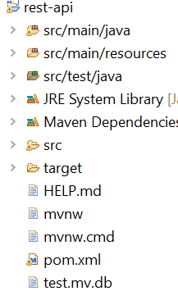
Application Structure
Frameworks make it easy with the of dependensies and its all taken care of by spring boot.

Slide 5
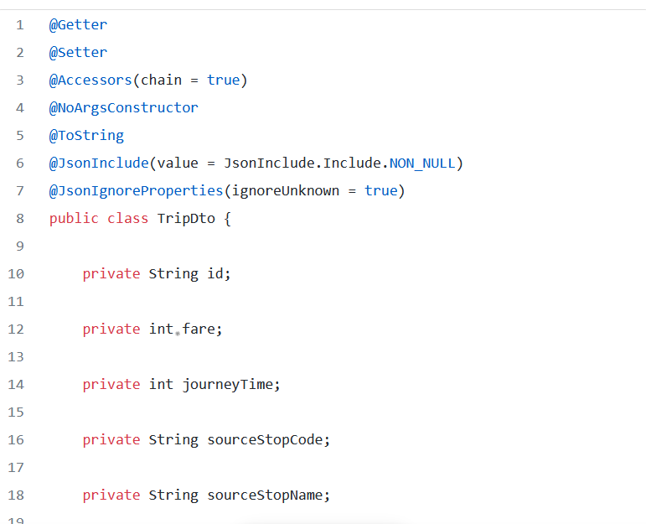
Model and DTO
Models and DTOs
DTO (Data Transfer Object)
DTO use to transfer data we need.
While this is not the same as a foreign key concept in MySQL and there is no default cascading applied here, it does give us a way to emulate the same in MongoDB.

Slide 6
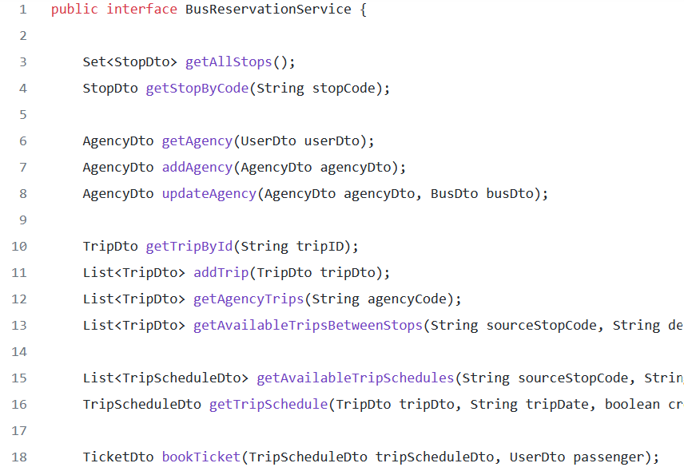
DAO (Data Access Object)
The data access objects (DAOs) are present in the repository package. They are all extensions of the MongoRepository interface helping the service layer to persist and retrieve the data from MongoDB.
Example DAO Config

Slide 7
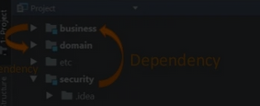
Security Spring Config
You can use start.spring.io to generate a basic project.
and you can create the project web + spring security IDE
The security setting are present under the config package and the actual configurations are done under the class present in the security package. The application has different security concepts for the admin portal and the REST APIs, for the portal I have applied the default spring session mechanism that is based on the concept of sessionID and cookies.

Slide 8
Lombok
One of the biggest complaints against Java is how much noise can be found in a single class. Project Lombok saw this as a problem and aims to reduce the noise of some of the worst offenders by replacing them with a simple set of annotations. You will find Lombok employed everywhere in this starter kit, it has actually helped in reducing the lines of code, save a lot of development time and effort and make the code a lot more readable.
Some of the most important annotations that I prefer using are :
@Getter
@Setter

Slide 9
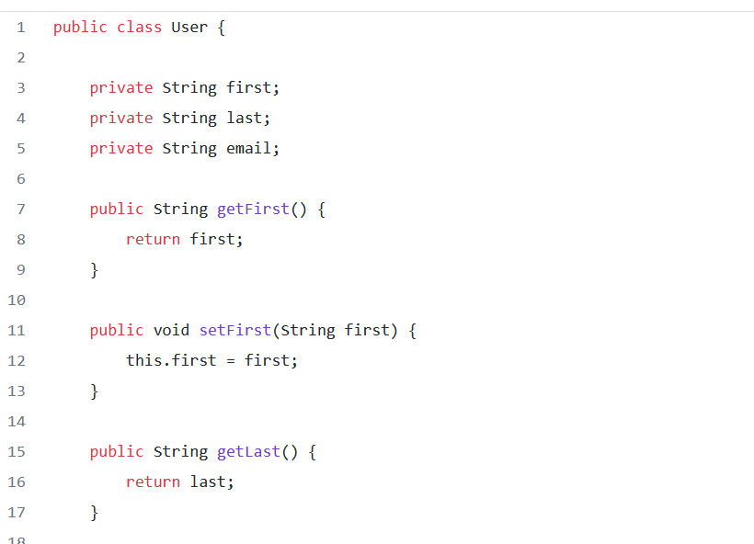
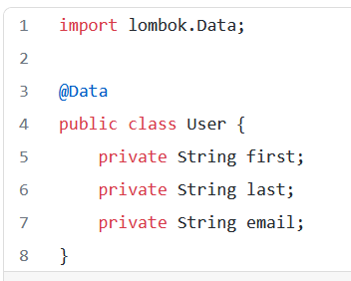
Lombok II
Example
Before Lombok
After Lombok

Slide 10
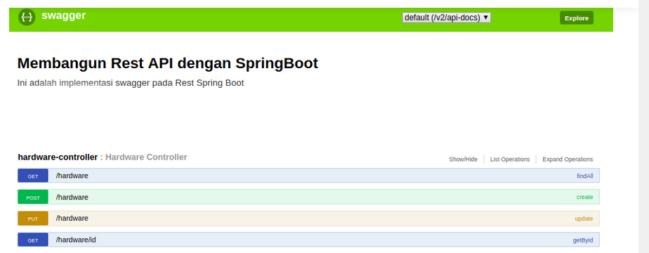
API Documentation
It is as important to document your work (as is its development) and make sure your Spring Boot APIs are available in a readable manner for frontend teams(internal) or external consumers.
The tool for API documentation used in this starter kit is Swagger2, you can open the same inside a browser.

